Slide 1

Noida Institute of Engineering and Technology, Gr. Noida
Introduction and Basic information about Legal System
Unit: 3
Constitution of India, Law and Engineering
Mr. Ajeet Singh
Assistant Professor, Department of ME
Course Details (B. Tech 5th Semester)

Slide 2

Faculty Biodata
Faculty Name: Ajeet Singh
Designation: Assistant Professor (Department of
Mechanical Engineering)
Area of Interest: Automation, Artificial Intelligence,
Mechatronics.
Educational Qualification:
B.Tech- Mechanical & Automation Engineering (Amity University U.P.)
M.Tech- Production Technology (Vinobha Bhave University J.H.)

Slide 3

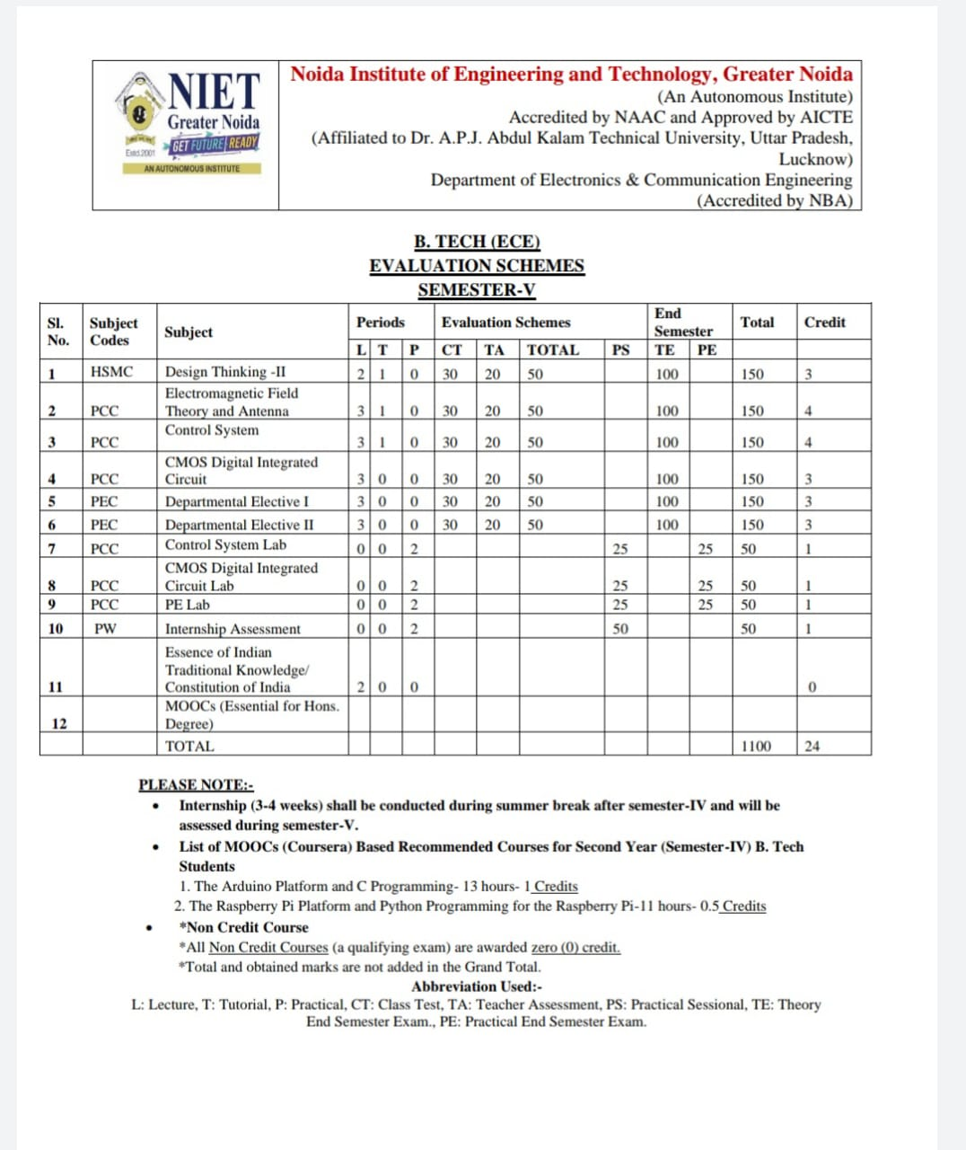
Evaluation Scheme

Slide 4

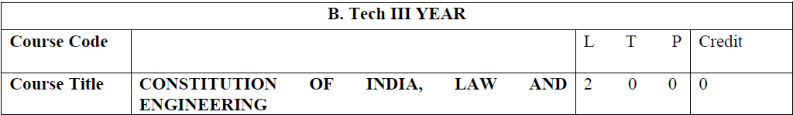
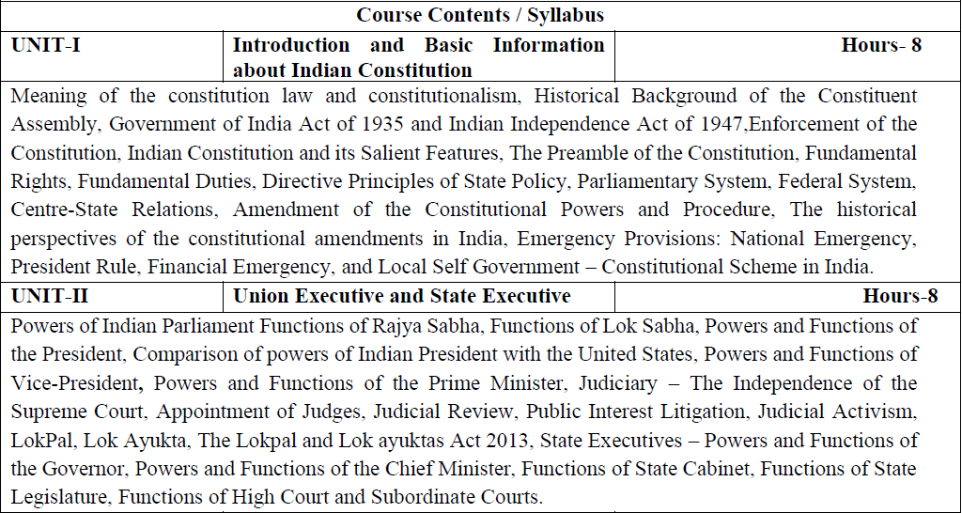
Syllabus

Slide 5

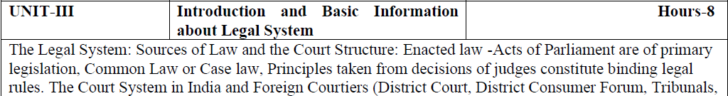
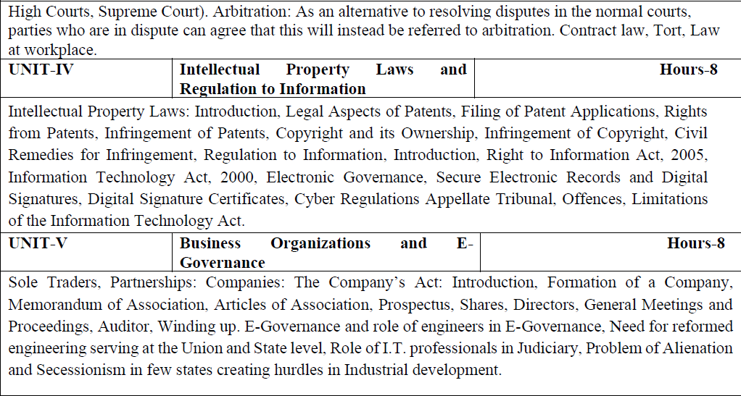
Syllabus

Slide 6

Branch wise Applications
Legal knowledge
Individual rights
Duties of a citizen
Patient filling
Business setup

Slide 7
Course Objectives (KNC-501)
Course Objectives:
The student will try to learn about:
To acquaint the students with legacies of constitutional development in India and help those to understand the most diversified legal document of India and philosophy behind it.
To make students aware of the theoretical and functional aspects of the Indian Parliamentary System.
To channelize students’ thinking towards basic understanding of the legal concepts and its implications for engineers.
To acquaint students with latest intellectual property rights and innovation environment with related regulatory framework.
To make students learn about role of engineering in business organizations and e-governance.

Slide 8
Course Outcome (CO) of Constitution of India,Law and Engineering (KNC-501)
Course Outcome:
After successful completion of the course students will demonstrate the ability to
CO1: Identify and explore the basic features and modalities about Indian constitution.
CO2: Differentiate and relate the functioning of Indian parliamentary system at the center and state level.
CO3: Differentiate different aspects of Indian Legal System and its related bodies.
CO4: Discover and apply different laws and regulations related to engineering practices.
CO5: Correlate role of engineers with different organizations and governance models

Slide 9

Program Outcomes
Program Outcomes are narrow statements that describe what the students are expected to know and would be able to do upon the graduation.
These relate to the skills, knowledge, and behavior that students acquire through the programmed.
Engineering knowledge
Problem analysis
Design/development of solutions
Conduct investigations of complex problems
Modern tool usage
The engineer and society
Environment and sustainability
Ethics
Individual and team work
Communication
Project management and finance
Life-long learning

Slide 10
CO-PO Mapping
COs | POs | PO1 | PO2 | PO3 | PO4 | PO5 | PO6 | PO7 | PO8 | PO9 | PO10 | PO11 | PO12 | PSO1 | PSO2 | PSO3
CO1 |  | - | - | - | - | - | - | - | 3 | - | - | - | 3 | - | - | -
CO2 |  | - | - | - | - | - | - | - | 3 | - | - | - | 3 | - | - | -
CO3 |  | - | - | - | - | - | - | - | 3 | - | - | - | 3 | - | - | -
CO4 |  | - | - | - | - | - | - | - | 3 | - | - | - | 3 | - | - | -
CO5 |  | - | - | - | - | - | - | - | 3 | - | - | - | 3 | - | - | -
Average |  | - | - | - | - | - | - | - | 3 | - | - | - | 3 | - | - | -
Note: Correlation levels are taken 1, 2 and 3 as defined below:
1: Slight (Low) 2: Moderate (Medium) 3: Substantial (High)
If there is no correlation, put ‘-’

Slide 11
Program Specific Outcomes
Program Specific Outcomes (PSOs) are what the students should be able to do at the time of graduation. The PSOs are program specific. PSOs are written by the department offering the program.
PSO1: To apply the knowledge of mathematics, science and electronics & communication engineering to work effectively in the industry based on same or related area.
PSO2: To use their skills to work in modern electronics & communication engineering tools, software and equipments to design solutions for complex problems in the related field that meet the specified needs of the society.
PSO3: To function effectively as an individual and as a member or leader of a team by qualifying through examinations like GATE (Graduate Aptitude Test in Engineering), IES (Indian Engineering Services), PSUs (Public Sector Undertakings), TOEFL (Test of English as a Foreign Language), GMAT (Graduate Management Admission Test) and GRE (Graduate Record Examinations in US) etc.

Slide 12
CO-PSO Mapping
COs | PSOs | PSO1 | PSO2 | PSO3
CO1 |  | - | - | -
CO2 |  | - | - | -
CO3 |  | - | - | -
CO4 |  | - | - | -
CO5 |  | - | - | -
Average |  | - | - | -
Note: Correlation levels are taken 1, 2 and 3 as defined below:
1: Slight (Low) 2: Moderate (Medium) 3: Substantial (High)
If there is no correlation, put ‘-’

Slide 13
Program Educational Objectives
The Program Educational Objectives (PEOs) of an engineering degree program are the statements that describe the expected achievements of graduates in their career, and what the graduates are expected to perform and achieve during the first few years after graduation.
PEO1: To have an excellent scientific and engineering breadth so as to comprehend, analyze, design and solve real-life problems using state-of-the-art technology.
PEO2: To lead a successful career in industries or to pursue higher studies or to understand entrepreneurial endeavours.
PEO3: To effectively bridge the gap between industry and academics through effective communication skill, professional attitude and a desire to learn.

Slide 14
Result Analysis
Department wise:
OVERALL CLEAR PASS STUDENTS | 65
OVERALL PASS % | 48.51%
SUBJECT | KME501 | KME502 | KME503 | KME051 | KME055 | KAU051 | KAU052 | KME052 | KME056 | KME551 | KME552 | KME553 | KME554 | KNC501
NO.OF BACKLOGS | 30 | 47 | 7 | 1 | 3 | 8 | 16 | 0 | 10 | 0 | 0 | 0 | 0 | 0
BACKLOG % | 22.39% | 35.07% | 5.22% | 0.75% | 2.24% | 5.97% | 11.94% | 0.00% | 7.46% | 0.00% | 0.00% | 0.00% | 0.00% | 0.00%
PASS % | 77.61% | 64.93% | 94.78% | 99.25% | 97.76% | 94.03% | 88.06% | 100.00% | 92.54% | 100.00% | 100.00% | 100.00% | 100.00% | 100.00%

Slide 15
Result Analysis
Faculty wise:
AJEET SINGH | Subject 1 (KME052) [section C] | SUBJECT 2(KNC 501) [section A] | SUBJECT 2(KNC 501 [section B] | SUBJECT 2(KNC 501) [section C] | SUBJECT 2( KNC 501) [section D]
BACKLOG | 0 | 0 | 0 | 0 | 0
PASS % | 100% | 100% | 100% | 100% | 100%
Subject wise:
Subject Code | Subject Name | Total Student | Backlog Number | Pass %
KNC 502 | COILE | 135 | 0 | 100%

Slide 16
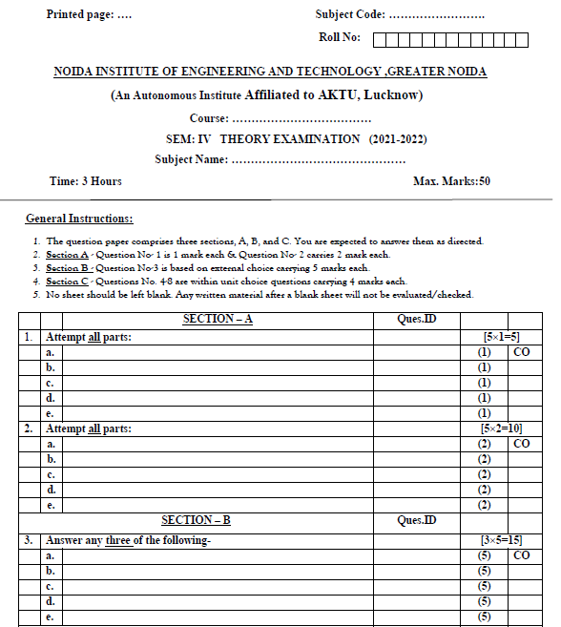
End Sem Question Paper Template

Slide 17
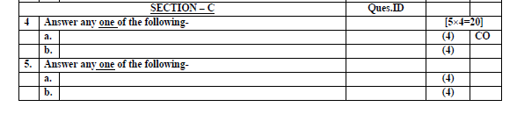
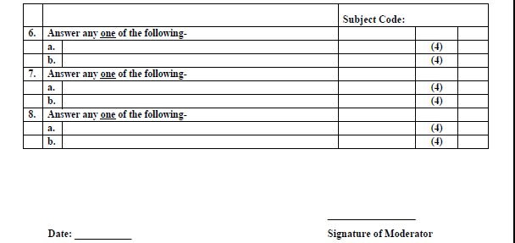
End Sem Question Paper Template

Slide 18
Prerequisite and Recap
The student should have knowledge of political science.

Slide 19
Brief Introduction about the subject with Video
To acquaint the students with legacies of constitutional development in India and help those to understand the most diversified legal document of India and philosophy behind it. To make students aware of the theoretical and functional aspects of the Indian Parliamentary System. To channelize students’ thinking towards basic understanding of the legal concepts and its implications for engineers. To acquaint students with latest intellectual property rights and innovation environment with related regulatory framework. To make students learn about role of engineering in business organizations and e-governance.
https://www.youtube.com/watch?v=iIvEZsaFqkQ

Slide 20
Content (Unit 3)
The Legal System: Sources of Law and the Court Structure: Enacted law -Acts of Parliament are of primary legislation, Common Law or Case law, Principles taken from decisions of judges constitute binding legal rules.
The Court System in India and Foreign Courtiers (District Court, District Consumer Forum, Tribunals, High Courts, Supreme Court).
Arbitration: As an alternative to resolving disputes in the normal courts, parties who are in dispute can agree that this will instead be referred to arbitration. Contract law, Tort, Law at workplace.

Slide 21
Unit Objective
To channelize students’ thinking towards basic understanding of the legal concepts and its implications for engineers

Slide 22
Topic Objective
Name of Topic | Objective of Topic | Mapping with CO
The Legal System: Sources of Law and the Court Structure: Enacted law -Acts of Parliament are of primary legislation, Common Law or Case law, Principles taken from decisions of judges constitute binding legal rules. | Students will be able to learn about the fundamentals of legal system in India. | CO3

Slide 23
The Legal System
What is Law?
Answer: Law is basically a set of rules that are created and enforce by a particular country or community through social or governmental institutions to regulate the actions of its members.
In the constitution of India, every citizen has been given several rights and since the rights are provided, there will infringement of those rights as well. Time to time legislature has introduced various laws to enforce and protect such rights, in order to civilize the society and maintain peace and harmony among the individuals.
India has a hybrid legal system having elements of civil law, common law, equitable law, and customary and religious laws.

Slide 24
Source of Law
The main sources of law are the following:
1. The Constitution of India: This is the supreme source of law.
2. Statutes : Statutes are enacted by the Parliament or the state legislatures. At local level, subordinate delegated legislation (such as rules, regulations and bye-laws) is passed by local authorities (such as government departments, municipal corporations, municipalities and gram panchayat).
3. Customary law : In certain aspects, local customs and conventions (usually religious in nature) that are not against any statute or morality are also applicable.
4. Judicial decisions: Judicial interpretation

Slide 25
Court Structure
The Constitution of India provides for a single integrated judicial system.
The structure of the judiciary in India is pyramidal with the Supreme Court at the top, High Courts below them and district and subordinate courts at the lowest level (see the diagram below).
The lower courts function under the direct superintendence of the higher courts.
The Supreme Court of India is the apex court of the country and sits in New Delhi.

Slide 26
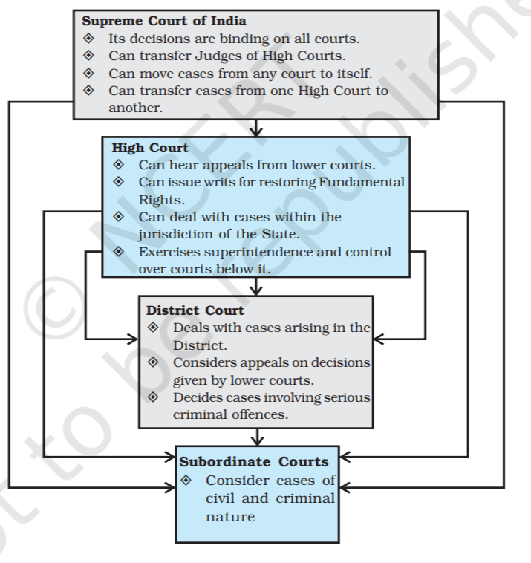
Court Structure: Clasification

Slide 27
Common Law or Case law
Common law, also known as case law, is law developed by judges through decisions of courts and similar tribunals.
A "common law system" is a legal system that gives great precedential weight to common law, on the principle that it is unfair to treat similar facts differently on different occasions.
The body of precedent is called "common law" and it binds future decisions.
If a similar dispute has been resolved in the past, the court is bound to follow the reasoning used in the prior decision. The principle by virtue of which this is followed is called stare decisis

Slide 28
Principles taken from decisions of judges
constitute binding legal rules
Article 141 states all courts are legally bound to the Supreme Court judicial decisions with the exception of Supreme Court itself. The Supreme Court is not bound by its own decisions.
However, the Supreme Court recognises that its earlier decisions cannot be deviated from, except in case of extenuating circumstances. If an earlier decision is found to be incorrect, the Supreme Court will deviate from it.
The first rule says that a court which is lower in a hierarchy is completely bound by the decisions of courts which are above it.

Slide 29
Principles taken from decisions of judges
constitute binding legal rules(cont..)
The second rule states that higher courts are bound by their own decision in general in matters of related to precedence.
The decisions of the high court are binding on all subordinate courts. In case of a conflict between two benches of similar authority, the latter decision is to be followed.
The more the number of judges on a bench, the higher their authority.
The decision of one high court is not binding on other high courts.
The Supreme court is the highest authority and its decisions are binding on all other courts.

Slide 30

Lecture Related to Topic
Legal system: https://www.youtube.com/watch?v=3j88YjqFj5U
Outline of legal system: https://www.youtube.com/watch?v=EnFRTG9Qv2Y
Source of law: https://www.youtube.com/watch?v=l2GG0Dq_xYE

Slide 31
Weekly assignment
Explain the term ‘Law’.
What are the major functions of Law?
What do you understand by the term Sources of law ? Briefly describe it.
Explain the court structure in India.
What do you understand by the term Acts of parliament ?

Slide 32
Daily Quiz
The law is derived mainly from two sources. Judge-made law is known as:
a) Statute law or legislation
b) Common law
c) Rule of law
d) Supreme law
Law made by Parliament is known as:
a) Supreme law
b) Common law
c) Rule of law
d) Statute law or legislation

Slide 33

Daily Quiz
Which of the following is NOT a domestic source of law?
a) Legislation
b) Case law
c) Hansard
d) Custom
The Court of Appeal is bound by the decisions of which court(s)?
a) Decisions of the House of Lords/Supreme Court only.
b) Decisions of the House of Lords/Supreme Court and generally its own decisions.
c) Decisions of the House of Lords/Supreme Court and the Judicial Committee of the Privy Council only.
d) The Court of Appeal is not bound by the decisions of any other courts.

Slide 34

Introduction of Topic 2
Name of Topic | Objective of Topic | Mapping with CO
The Court System in India and Foreign Courtiers (District Court, District Consumer Forum, Tribunals, High Courts, Supreme Court). | Students will be able to learn about the Court system in India. | CO3

Slide 35
District Court
The state judiciary consists of a high court and a hierarchy of subordinate courts, also known as lower courts.
The subordinate courts are so called because of their subordination to the state high court. They function below and under the high court at district and lower levels.
Articles 233 to 237 in Part VI of the Constitution make the following provisions to regulate the organization of subordinate courts and to ensure their independence from the executive.
The district judge is the highest judicial authority in the district. He possesses original and appellate jurisdiction in both civil as well as criminal matters.

Slide 36
District Consumer Forum
Under the provisions of the Consumer Protection Act, 1986 there is a three tier quasi-judicial mechanism at the District, State and National levels to provide simple and speedy resolution to consumer disputes. At the district level it is called District Consumer Disputes Redressal Forum (District Forum).
It has jurisdiction to entertain consumer complaints where the value of goods/services including compensation claimed , if any is upto Rs. 20 Lakhs.
At the state level it is known as State Consumer Disputes Redressal Commission (State Commission). It has jurisdiction to entertain consumer complaints where the value of goods/services and compensation claimed if any upto Rs. 1 Crore and appeals against orders of Distrci Forum.

Slide 37
Tribunals
Tribunals are institutions established for discharging judicial or quasi-judicial duties. The objective may be to reduce case load of the judiciary or to bring in subject expertise for technical matters.
The Supreme Court has ruled that tribunals, being quasi-judicial bodies, should have the same level of independence from the executive as the judiciary, key factors include the mode of selection of members, the composition of tribunals, and the terms and tenure of service.
They intend to provide a platform for faster adjudication as compared to traditional courts, as well as expertise on certain subject matters.

Slide 38
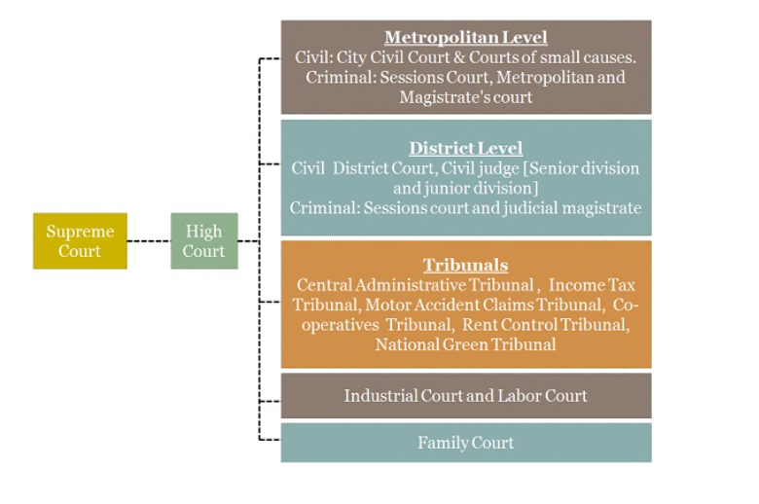
Tribunals

Slide 39
High Courts
There shall be High Court for each State (Article 214), and every High Court shall be a Court of record and shall have all the powers of such a Court including the power to punish for contempt of itself (Article 215).
The writ jurisdiction of High Court means issuance of Writs/orders for the enforcement of Fundamental Rights and also in cases of ordinary legal rights. High Court also has the power to superintend over all other courts and tribunals, except those dealing with armed forces.
High Courts’ power of original and appellate jurisdiction is also circumscribed by the creation of Central Administrative Tribunals, with respect to services under the Union and it has no power to invalidate(declare void) a Central Act, rule, notification or order made by any administrative authority of the Union.

Slide 40
Supreme Court
The Supreme Court has vast jurisdiction and its position is strengthened by the fact that it acts as a Court of Appeal, as a guardian of the Constitution and as a reviewer of its own judgements.
Article 141 declares that the law laid down by the Supreme Court shall be binding on all courts within the territory of India.
Article 131 gives the Supreme Court exclusive and original jurisdiction in a dispute between the Union and a State, or between one State and another, or between a group of States and others.
The Supreme Court is the highest Court of Appeal from all courts.

Slide 41
Lecture Related to Topic
Court system in india: https://www.youtube.com/watch?v=6CS3WwY2_h8
Supreme Court: https://www.youtube.com/watch?v=7hnKGOgjYNI
High Court: https://www.youtube.com/watch?v=SXeKCB8WPGg

Slide 42
Weekly assignment
Which is the highest Criminal Court in a District?
Name the highest Civil Court of a District?
Write a short note on Supreme Court of India.
Write a short note on High Courts in India.
What do you understand by the term Tribunals ? What is the need of Tribunal ?
Write a short note on district consumer forum in India.
Write a short note on district courts in India.
What is the general court structure and hierarchy in India ?

Slide 43
Daily Quiz
Consider the following statements: 1. District judge exercises both judicial 7 administrative powers. 2. Sessions judge has no power to impose capital punishment. Which of the statements given above is / are correct?
Only 1
Only 2
Both 1 and 2
Neither 1 nor 2
Who can remove the Judge of the Supreme Court?
Chief Justice of the Supreme Court
Only the President
Only the Parliament
Both Parliament and President

Slide 44
Daily Quiz
The President can declare a judge an executive chief justice of the Supreme Court of India when ...
The post of Chief Justice of India is vacant
Chief Justice of India is temporarily absent
Chief Justice of India is unable to discharge his obligations
All of the above
Which of the following articles states about the establishment of the district Court?
Article 142
Article 233
Article 214
Article 324

Slide 45
Introduction of Topic 3
Name of Topic | Objective of Topic | Mapping with CO
Arbitration: As an alternative to resolving disputes in the normal courts, parties who are in dispute can agree that this will instead be referred to arbitration. Contract law, Tort, Law at workplace. | Students will be able to learn about the Arbitration system in India. | CO3

Slide 46
Arbitration
It is a well known fact that the present Judicial System is extremely expensive and delaying. The parties to a dispute have to wait for Justice for years.
This lengthy and expensive process of litigation has reduced the faith of common people in the Judicial System being followed by the Courts. These weaknesses of Judicial System has given birth to alternative remedies for the disposition of disputes.
Alternative remedies provide cheap and speedy Justice and that is the reason that ADR mechanism is being preferred by the disputing parties for the resolution of their disputes.

Slide 47
Arbitration
ADR refers to the methods of resolving a dispute, which are alternatives for litigation in Courts.
ADR processes are decision making processes that do not involve litigation or violence. In India, an alternative system is available to the disputing parties including Arbitration, Conciliation, Mediation, Negotiation etc.
ADR proceedings are flexible. The parties have the freedom to choose the applicable law. They can be conducted in any manner and in the language to which the parties agree. The matter may be settled in few meetings thereby reducing expenses. No court fee is payable. No expenses are involved in obtaining copies of proceedings and reports.

Slide 48
Arbitration
Arbitration is a method whereby parties can resolve their disputes privately. In this mechanism parties can refer their case to an Arbitral Tribunal where arbitration proceedings are conducted.
Where two or more persons agree that a dispute or potential dispute between them shall be decided in a legally binding way by one or more impartial persons in a judicial manner, that is, after recording evidence, the agreement is called an Arbitration Agreement. When, after a dispute has arisen, it is put before such person(s), the procedure is called as ‘Arbitration’, and the decision made is called “award”.
The person conducting the Arbitration proceeding is called an Arbitrator.

Slide 49
Contract law
A contract is a legally enforceable agreement between two or more parties where each assumes a legal obligation that must be completed.
Many aspects of daily life involve contracts, including buying property, applying for a car loan, signing employment-related paperwork, and agreeing to terms and conditions when buying products and services or using computer software.
Legal issues involving contracts arise most often when one party fails to perform the legal obligation it has agreed to do.
When a party breaches a contract by failing to perform, the other party can often sue for money damages, or, in some limited cases, can ask the court to force the other party to perform as promised.

Slide 50
Tort
A tort is an act or omission that gives rise to injury or harm to another and amounts to a civil wrong for which courts impose liability.
In the context of torts, "injury" describes the invasion of any legal right, whereas "harm" describes a loss or detriment in fact that an individual suffers.
Torts are distinguishable from crimes, which are wrongs against the state or society at large.
The main purpose of criminal liability is to enforce public justice. In contrast, tort law addresses private wrongs and has a central purpose of compensating the victim rather than punishing the wrongdoer.

Slide 51
Law at workplace
Factories Act, 1948
Shops and Commercial Establishments Act
Industrial Employment (Standing Orders) Act, 1946
Contract Labour (Regulation & Abolition) Act, 1970
The Employee’s Compensation Act, 1923
Weekly Holiday Act, 1942
The Mines Act, 1952
Inter-state Migrant Workmen (Regulation of Employment and Conditions of Service) Act, 1979
Maternity Benefit Act, 1961

Slide 52
Lecture Related to Topic
Arbitration: https://www.youtube.com/watch?v=D3yQEoXkiAA
Law of tort: https://www.youtube.com/watch?v=N8nRnralqiI
Contract act: https://www.youtube.com/watch?v=t96A1DrsZTw

Slide 53
Weekly assignment
What is the need of having Alternative Dispute Resolution (ADR)?
What are the advantages of Alternative Dispute Resolution (ADR)?
List the different Techniques of Alternative Dispute Resolution (ADR)?
What are the various laws relating to workplace in India ?
What do you understand by the term Tort ?
What do you understand by the term contract law ? Also mention the essential elements of a contract.
Describe Arbitration and Conciliation Act of 1996.
Describe rights and duties of arbitrators.
What do you understand by the term Arbitration ? Also mention types of Arbitration.

Slide 54
Daily Quiz
What are the conditions for commencement of conciliation proceedings:
The party initiating conciliation shall send to the other party a written invitation to conciliate briefly identifying the subject of the dispute.
The party initiating conciliation should receive a reply within thirty days from the date on which he sends the invitation to other party.
Acceptance writing the invitation to conciliate by the other party, if the other party rejects the invitation, there will be no conciliation proceedings
All the options are correct.

Slide 55
Daily Quiz
Arbitral Tribunal” means:
Only panel of arbitrators
A sole arbitrator or a panel of arbitrators
More than one arbitrator
Only a sole arbitrator
The purpose of Arbitration Act is to provide quick redressal to __________by private arbitration.
family disputes
service disputes
commercial disputes
political disputes

Slide 56
Daily Quiz
Choose the correct objective of the Industrial Disputes Act.
a) To prevent illegal strikes
b) To promote measures for securing and preserving good relations between the employers and the employees
c) To provide relief to workmen in matters of lay - offs, retrenchment, wrongful dismissals
d) All of the above

Slide 57
Youtube & NPTEL link
https://www.youtube.com/watch?v=D3yQEoXkiAA
https://www.youtube.com/watch?v=N8nRnralqiI
https://www.youtube.com/watch?v=t96A1DrsZTw
https://www.youtube.com/watch?v=6CS3WwY2_h8
https://www.youtube.com/watch?v=7hnKGOgjYNI
https://www.youtube.com/watch?v=SXeKCB8WPGg

Slide 58
Assignment
Which is the highest Criminal Court in a District?
Name the highest Civil Court of a District?
Write a short note on Supreme Court of India.
Write a short note on High Courts in India.
What do you understand by the term Tribunals?
Describe Arbitration and Conciliation Act of 1996.
Describe rights and duties of arbitrators.
What do you understand by the term Arbitration ? Also mention types of Arbitration.

Slide 59
MCQ
Which is not the part of law at workplace?
Factories Act, 1948
Shops and Commercial Establishments Act
Industrial Employment (Standing Orders) Act, 1946
Family court
Which of the following is the meaning of Customary law?
Law enacted by the Parliament
Law enacted by the State assembly
In certain aspects, local customs and conventions
Judicial interpretation

Slide 60
MCQ
Who have the power to make rules:
The Supreme Court may make rules consistent with this Act as to all proceedings before the Court under this Ac
The Central Government may make rules consistent with this Act as to all proceedings before the Court under this Act.
The High Court may make rules consistent with this Act as to all proceedings before the Court under this Act.
None of the above

Slide 61
MCQ
Indian contract act effective from:
a) 1947
b) 1950
c) 1872
d) 1861
Jurisdiction of Lakshadweep comes under __________?
Tamil nadu HC
Kerala HC
Karnataka HC
None of The Above

Slide 62
MCQ
If a High Court judgment is issued in a state’s official language ,a translation in ___________must also be made available?
Hindi
English
Both of the above
Local language
In order to facilitate the conduct of the arbitral proceedings, the parties, or the arbitral tribunal with the consent of the parties:
May arrange for the settlement of the case
May arrange to provide legal aid.
May arrange for administrative assistance by a suitable institution or person.
May arrange for the reconciliation in the matter

Slide 63
Glossary Questions
Pick the correct answer from given Glossary:
1. ________is an example of a criminal law legislation.
2. ________is considered to be the basic as well as the supreme law of the country.
3. _______deals with the powers and functions of administrative.
______deals with acts which are prohibited by law and defines the prohibited act as an offence.
Criminal Law | Indian Penal Code | Constitutional law | Administrative Law

Slide 64
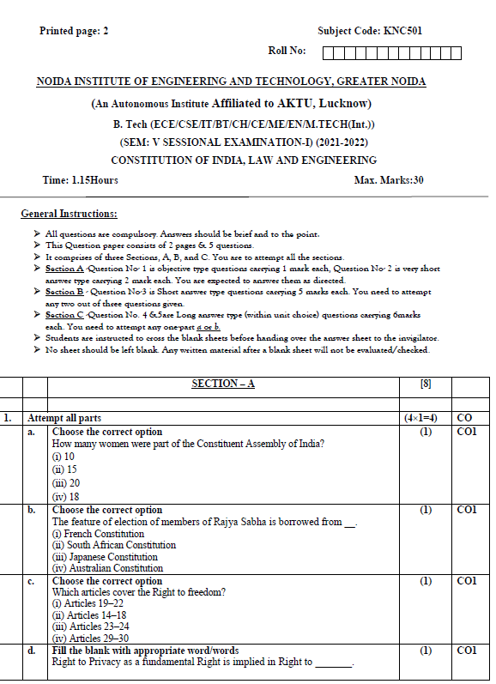
Sessional paper - I

Slide 65
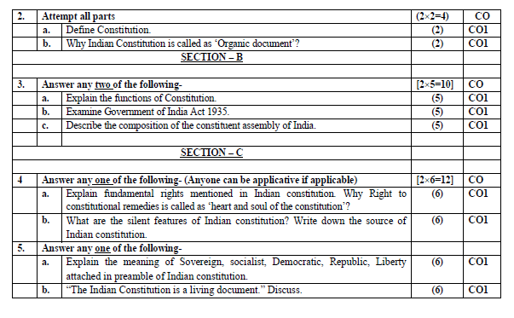
Sessional paper - I

Slide 66
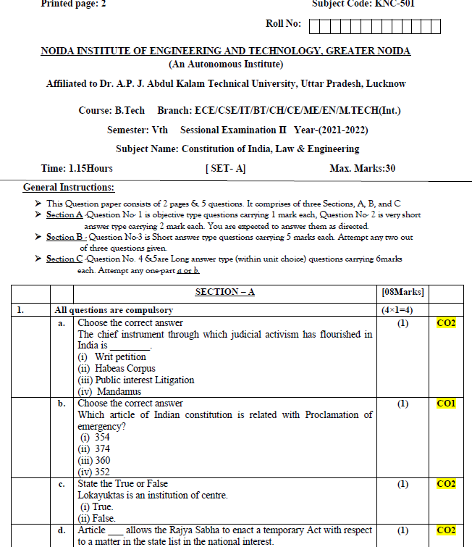
Sessional paper -II

Slide 67
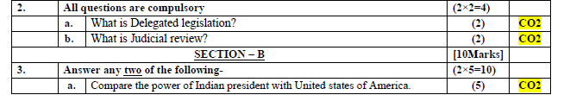
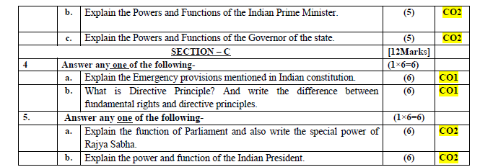
Sessional paper -II

Slide 68
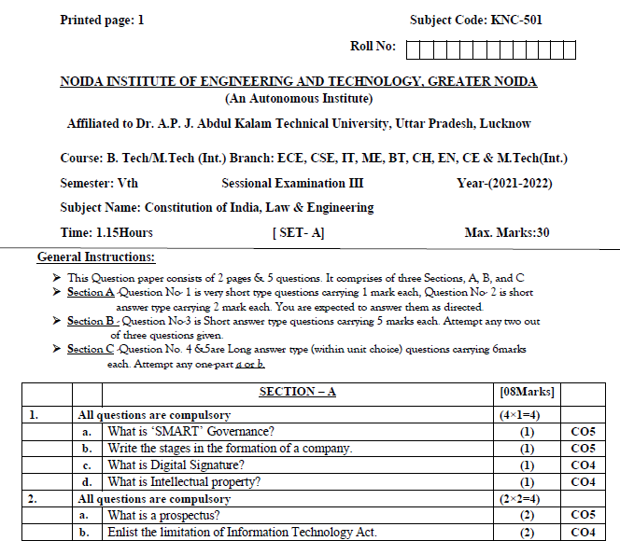
Sessional paper -III

Slide 69
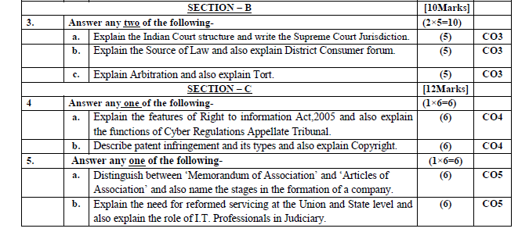
Sessional paper -III

Slide 70
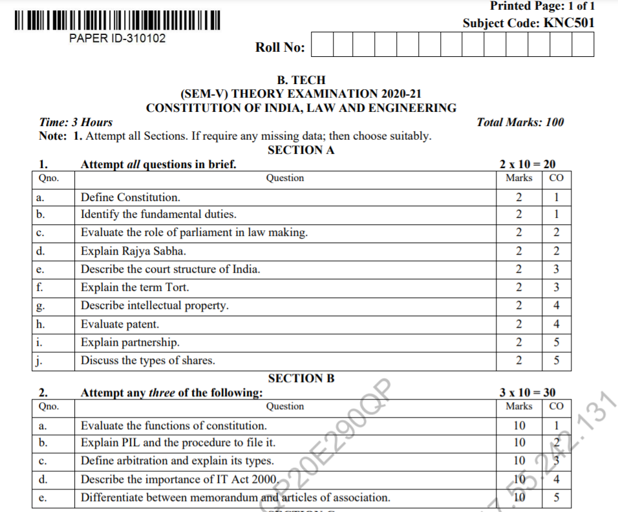
Old Question Papers

Slide 71
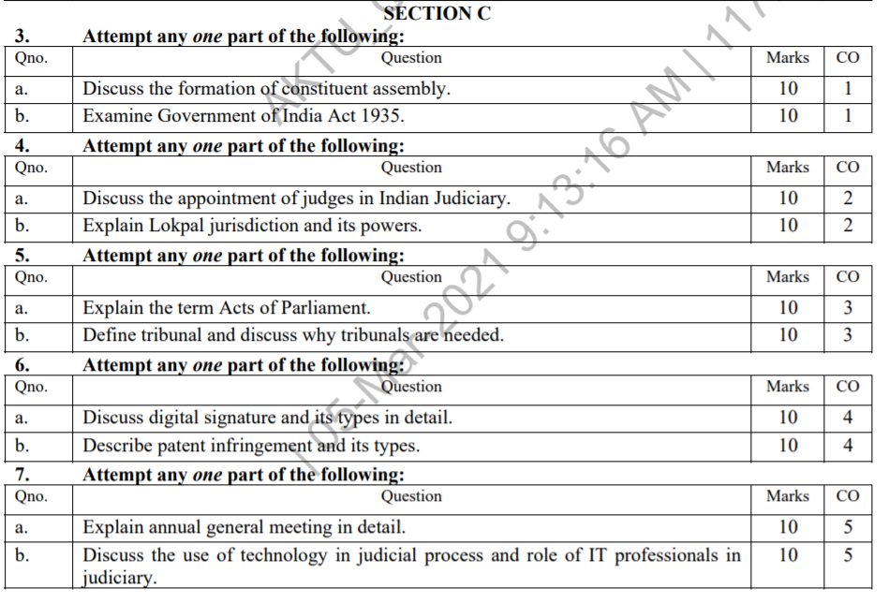
Old Question Papers

Slide 72

Expected Questions for
University Exam
Which is the highest Criminal Court in a District?
Name the highest Civil Court of a District?
Write a short note on Supreme Court of India.
Write a short note on High Courts in India.
What do you understand by the term Tribunals?
Describe Arbitration and Conciliation Act of 1996.
Describe rights and duties of arbitrators.
What do you understand by the term Arbitration ? Also mention types of Arbitration.

Slide 73
Recap
India has a single integrated judicial system.
The judiciary in India has a pyramidal structure with the Supreme Court (SC) at the top.
High Courts are below the SC, and below them are the district and subordinate courts.
The lower courts function under the direct superintendence of the higher courts.

